Slide 1
BHF-NIHR Coronary Microvascular Dysfunction Workstream
Colin Berry
Professor of Cardiology University of Glasgow
Consultant Cardiologist, NHS Golden Jubilee
Madrid, 2nd September 2025

Slide 2
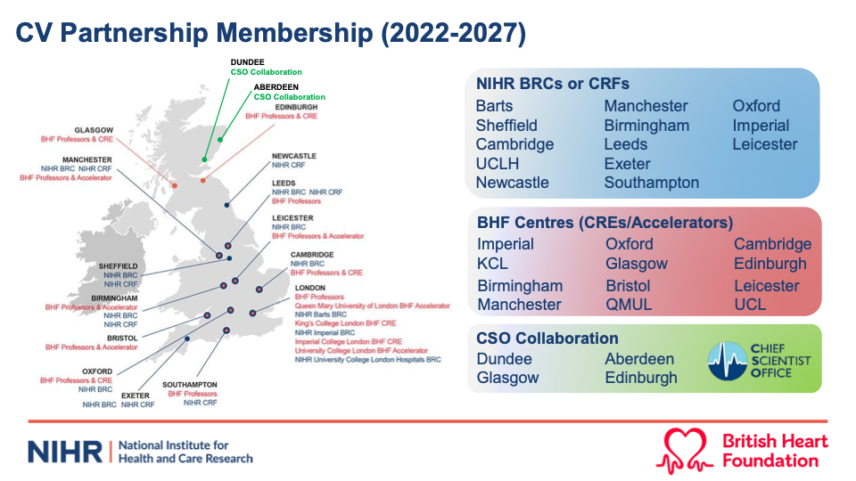

Slide 5
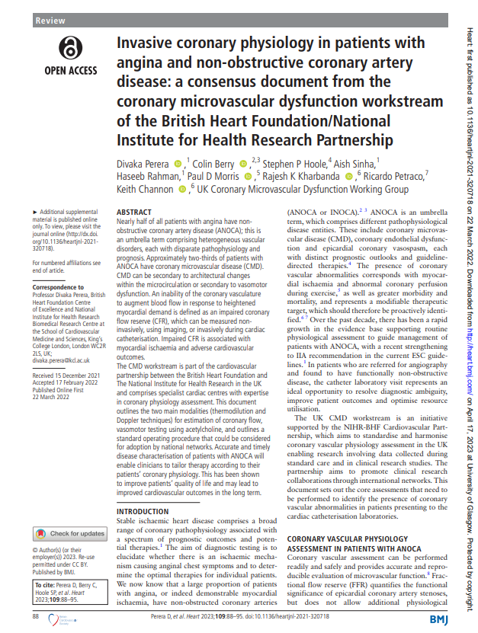

Slide 6

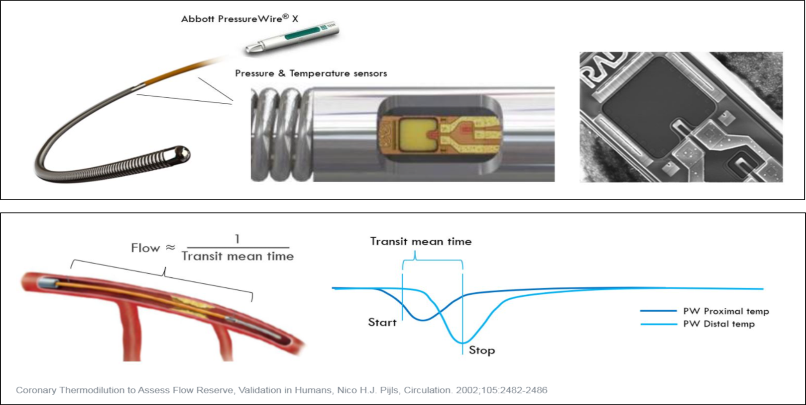

Angina
No obstructive CAD
Obstructive CAD
Ineligible for randomisation
Registry
Follow-up
1 year
SAQ
Double-blind

Slide 7
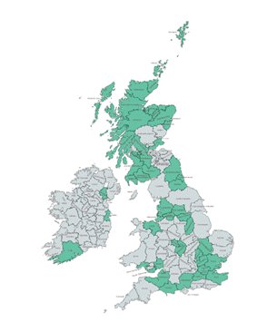
Recruitment update 21/08/2025)
NHS Sites |  | Patients Enrolment
Site Name (Site No.) | Opening date | Randomised/Registry
 |  | Total | Change from last update
Total |  | 903/370 | 22/3
Golden Jubilee (01) | 17.12.20 | 106/80 | 4/0
Blackpool (03) | 18.08.21 | 13/7 | 0/1
Belfast (05) | 24.01.24 | 8/4 | 0/0
Cambridge (07) | 27.01.22 | 32/18 | 0/0
Leeds (08) | 08.03.22 | 32/13 | 2/0
Sheffield (09) | 13.02.23 | 15/1 | 0/0
Cardiff (10) | 02.08.22 | 22/2 | 0/0
Wolverhampton (11) | 22.11.21 | 28/22 | 0/0
Nottingham (14) | 04.11.22 | 21/4 | 0/0
Liverpool (15) | 26.11.21 | 19/23 | 0/0
Hairmyres (17) | 30.09.21 | 121/73 | 1/0
Royal Free Hospital London (19) | 25.10.22 | 16/9 | 1/0
Blackburn (20) | 14.03.22 | 42/27 | 2/0
Southampton (21) | 03.10.24 | 6/1 | 0/0
Glan Clwyd (25) | 13.12.22 | 17/3 | 0/0
Sunderland (26) | 06.04.22 | 47/6 | 2/0
Freeman Hospital Newcastle (27) | 05.10.22 | 24/2 | 0/0
Bedford (29) | 05.05.22 | 69/9 | 1/0
Portsmouth (31) | 28.04.23 | 17/4 | 0/0
Morrison Hospital Swansea (32) | 09.02.23 | 27/7 | 0/0
William Harvey Hospital, Ashford (34) | 30.01.23 | 18/8 | 0/0
Northwick Park (35) | 23.08.23 | 36/7 | 0/0
Pinderfields Hospital (36) | 10.09.24 | 21/4 | 0/0
Raigmore Hospital (38) | 24.01.24 | 9/1 | 0/0
King’s College Hospital (39) | 15.09.23 | 19/3 | 2/1
Sandwell & District Hospital, B/ham (40) | 14.11.23 | 4/4 | 0/1
St Peter’s Hospital, Chertsey (42) | 22.05.24 | 6/5 | 0/0
The Grange University Hosp, Newport (43) | 30.05.24 | 5/0 | 0/0
Coventry University Hospital (44) | 18.07.24 | 6/2 | 0/0
Radboudumc, Nijmegen, Netherlands (45) | 03.06.25 | 8/0 | 7/0
5th Military Hospital, Krakow, Poland (46) | 11.08.25 | 0/0 | 0/0
Recruitment
21 August 2025
Sites | Enrolled | Randomised | Registry
31 | 1,273 | 903 | 370

Slide 8
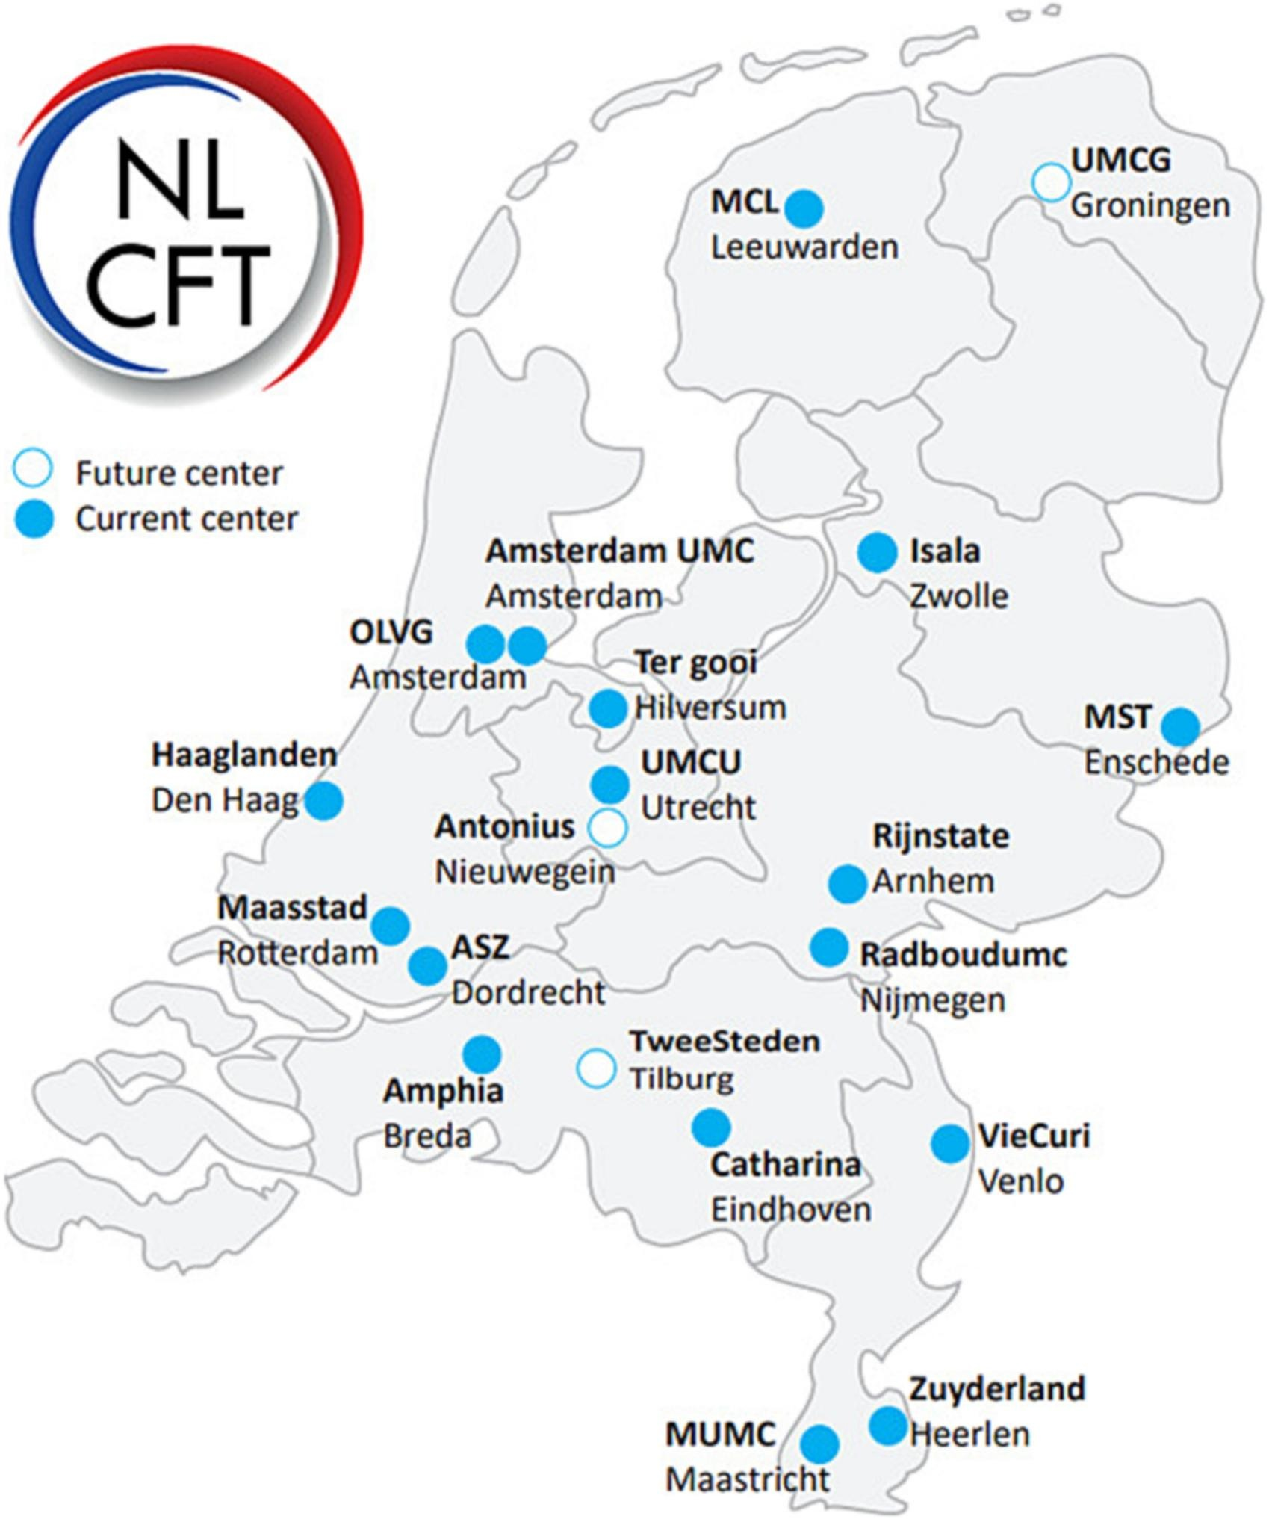
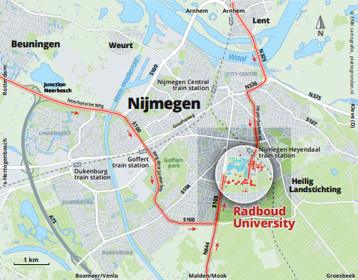
iCorMicA in The Netherlands
Peter Damman,
Open: 3 June 2025
8 patients randomised

Slide 9

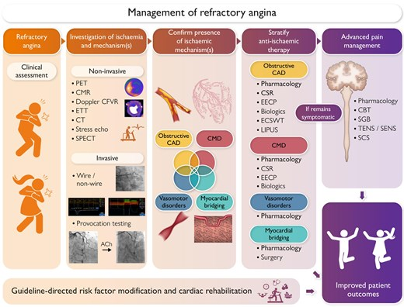

Slide 10
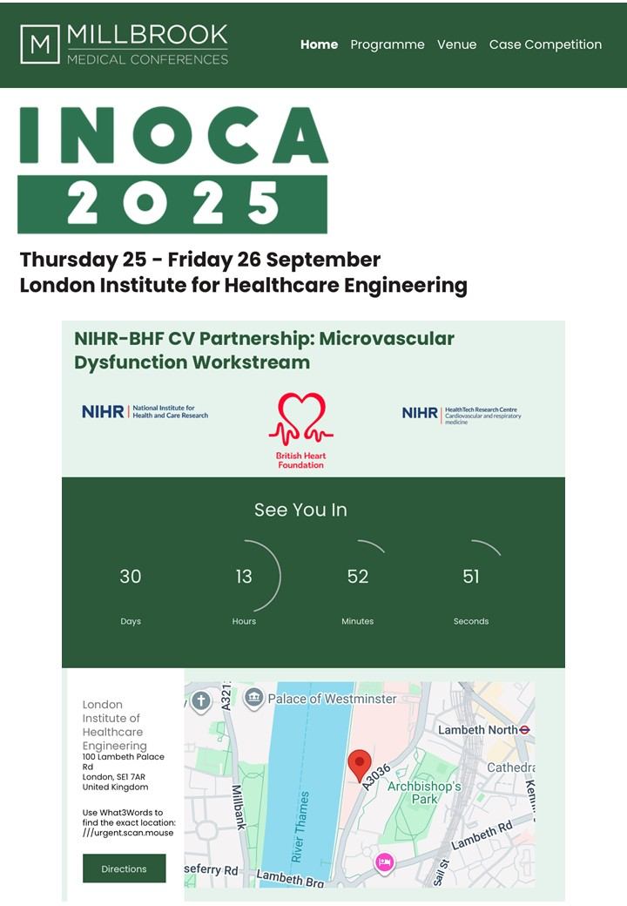
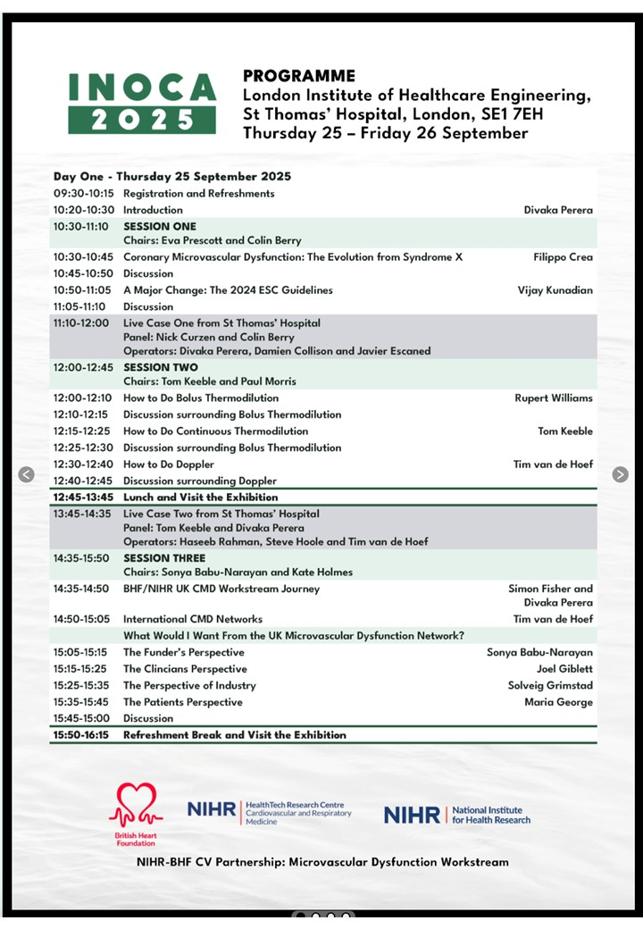
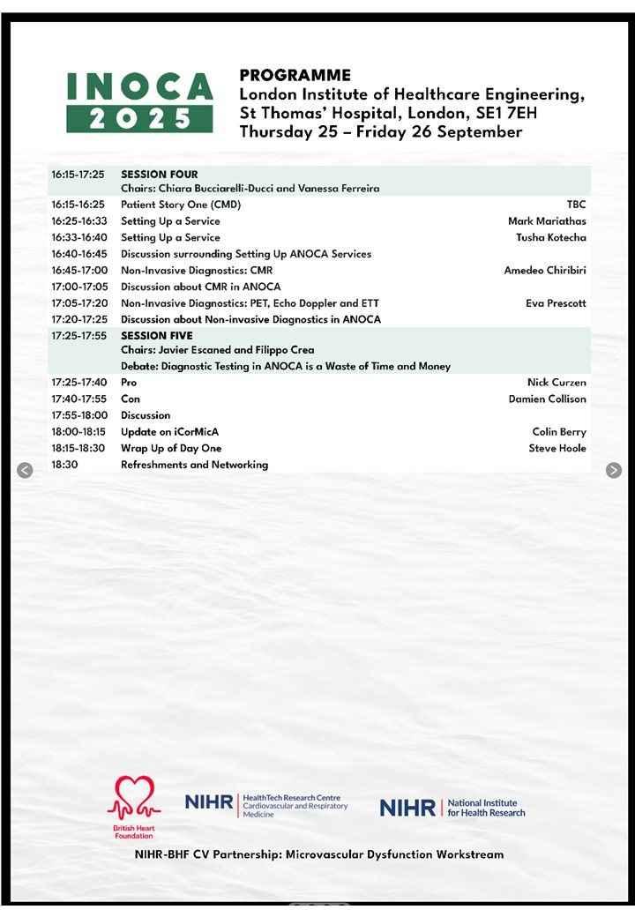

Slide 11
Thank you for your attention
Colin.berry@glasgow.ac.uk
divaka.perera@kcl.ac.uk

